Slide 1
UNIT IV
HIVE & PIG

Slide 2
HIVE
Introduction to Hive
Hive Architecture
Hive Data Types
Hive File Format
Hive Query Language (HQL)
User-Defined Function (UDF) in Hive.

Slide 3
PIG
Introduction to Pig
The Anatomy of Pig
Pig on Hadoop
Pig Philosophy
Use Case for Pig: ETL Processing
Pig Latin Overview
Data Types in Pig ,
Running Pig , Execution Modes of Pig, HDFS Commands,
Relational Operators, Piggy Bank ,
Word Count Example using Pig ,
Pig at Yahoo!,
Pig versus Hive

Slide 4
HIVE
Hive is a Data Warehousing tool.
Developed by Facebook to manage their ever-growing volumes of log data in the year 2007.
In 2008 it became Apache Hadoop sub-project.
Hive is used to query structured data built on top of Hadoop.
It resides on top of Hadoop to summarize Big Data, and makes querying and analyzing easy.
Hive makes use of the following:
HDFS FOR storage
MapReduce for execution
Stores metadata in an RDBMS

Slide 5
HIVE
HIVE is a data warehousing tool.
Hive suitable for Data warehousing applications.
Hive processes batch jobs on huge data that is immutable.
Web logs, Applications logs.

Slide 6
Recent Releases of HIVE
Hive 0.10
Batch
Read-Only Data
HiveQL
MR
Hive 0.13
-Interactive
-Read-Only Data
- Substantial SQL
- MR, TEZ
Hive 0.14
Transactions with ACID semantics
Cost based optimizer
SQL temporary tables.

Slide 7
Features of Hive
It is similar to SQL.
It provides SQL type language for querying called HiveQL or HQL, which is easy to code.
Hive supports rich data types such as structs, lists, and maps.
Hive suppots SQL filters, group-by and order-by clauses.
Custom types, custom functions can be defined.

Slide 8
Hive Data Units
Databases : The namespace for tables
Tables: Set of records that have similar schema.
Partitions: Logical separations of data based on classification of given information as per specific attributes.
Buckets or clusters : Similar to partitions but uses hash function to segregate data and determines the cluster or bucket into which the record should be placed.

Slide 9
Data units arranged in HIVE
Databases
Tables
Tables
Partitions
Buckets
Columns
Columns
Columns
Columns
Data
Data

Slide 10
Hive data units
A database contains several tables.
Each table is constituted of rows and columns.
In Hive tales are stored as a folder
Partition tables are stored as sub-directory.
Bucketed tables are stored as a file.

Slide 11
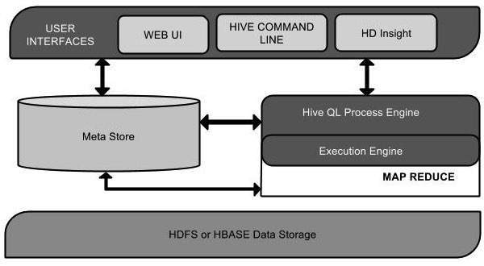
HIVE Architecture

Slide 12
HIVE
Command-Line Interface
HIVE web interface
HIVE server (Thrift)
Driver (Query Compiler, executor)
Metastore
Job Traker
Task Tracker
HDFS
Hadoop
HIVE Architecture

Slide 13
User Interface
Hive is a data warehouse infrastructure software that can create interaction between user and HDFS.
The user interfaces that Hive supports are Hive Web UI, Hive command line, and Hive HD Insight (In Windows server).
HIVE command-Line Interface (Hive CLI): The most commonly used interface to interact with HIVE.
Hive Web Interface: It is a simple Graphic user Interface to interact with Hive and to execute query.
Hive Server: This is an optional server. This can be used to submit Hive jobs from a remote client.

Slide 14
Meta Store
Hive chooses respective database servers to store the schema or Metadata of tables, databases, columns in a table, their data types, and HDFS mapping.
Meta store consists of the following:
Metastore service: Offers interface to the Hive.
Database: Stores data definitions, mappings to the data and others.

Slide 15
HiveQL Process Engine
HiveQL is similar to SQL for querying on schema info on the Metastore.
It is one of the replacements of traditional approach for MapReduce program.
Instead of writing MapReduce program in Java, we can write a query for MapReduce job and process it.

Slide 16
Execution Engine
The conjunction part of HiveQL process Engine and MapReduce is Hive Execution Engine.
Execution engine processes the query and generates results as same as MapReduce results. It uses the MapReduce.

Slide 17
HDFS or HBASE
Hadoop distributed file system or HBASE are the data storage techniques to store data into file system.

Slide 18
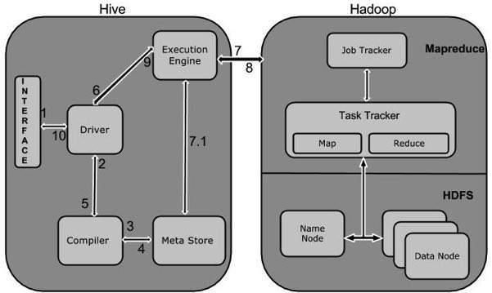
Working of Hive

Slide 19
Meta store
There are three kinds of metastore.
Embedded Metastore
Local Metastore
Remote Metastore

Slide 20
Embedded Metastore
Hive Service JVM
Driver
Derby
Metastore
This metastore is mainly used for unit tests.
Here one process is allowed to connect to the metastore at a time.
This is the default metastore for HIVE.
It is Apache Derby Hive Server Process.

Slide 21
Local Metastore Metastore
Hive Service JVM
Driver
MySQL
Metastore
Driver
Metastore
Metadata can be stored in any RDBMS component like MySQL.
Local Metastore allows multiple connections at a time.
In this mode, the Hive metastore service runs in the main Hive Server process,
but he metastore database runs in a separate process on separate host.

Slide 22
Remote Metastore
Hive Service JVM
Driver
MySQL
Metastore Server JVM
Driver
Metastore Server JVM
The Hive driver and the metastore interface run on different JVMs.
The databased can be fire-walled from the Hive User and also database
credentials are completely isolated from the users of Hive.

Slide 23
Hive Data Types
All the data types in Hive are classified into four types, given as follows:
Column Types
Literals
Null Values
Complex Types
Column Types
Column type are used as column data types of Hive. They are as follows:
Integral Types
String Types
Dates
Decimals
Integer type data can be specified using integral data types, INT. When the data range exceeds the range of INT, you need to use BIGINT and if the data range is smaller than the INT, you use SMALLINT. TINYINT is smaller than SMALLINT.
The following table depicts various INT data types:
Type Postfix Example
TINYINT Y 10Y
SMALLINT S 10S
INT - 10
BIGINT L 10L

Slide 24
String Types
String type data types can be specified using single quotes (' ') or double quotes (" ").
It contains two data types: VARCHAR and CHAR.
Hive follows C-types escape characters.
The following table depicts various CHAR data types:
Data Type Length
VARCHAR 1 to 65355
CHAR 255
Timestamp
It supports traditional UNIX timestamp with optional nanosecond precision. It supports java.sql.Timestamp format “YYYY-MM-DD HH:MM:SS.fffffffff” and format “yyyy-mm-dd hh:mm:ss.ffffffffff”.

Slide 25
Dates
DATE values are described in year/month/day format in the form {{YYYY-MM-DD}}.
Decimals
The DECIMAL type in Hive is as same as Big Decimal format of Java. It is used for representing immutable arbitrary precision. The syntax and example is as follows:
DECIMAL(precision, scale) decimal(10,0)
Union Types
Union is a collection of heterogeneous data types. You can create an instance using create union. The syntax and example is as follows:
UNIONTYPE<int, double, array<string>, struct<a:int,b:string>> {0:1} {1:2.0} {2:["three","four"]} {3:{"a":5,"b":"five"}} {2:["six","seven"]} {3:{"a":8,"b":"eight"}} {0:9} {1:10.0}

Slide 26
Complex Types
The Hive complex data types are as follows:
Arrays
Arrays in Hive are used the same way they are used in Java.
Syntax: ARRAY<data_type>Maps
Maps in Hive are similar to Java Maps.
Syntax: MAP<primitive_type, data_type>Structs
Structs in Hive is similar to using complex data with comment.
Syntax: STRUCT<col_name : data_type [COMMENT col_comment], ...>

Slide 27
HIVE FILE FORMAT
Text File
Each record is a line in the file.
Different control characters are used as delimiters.
CSV, TSV , JSON or XML
Sequential File
Sequential files are flat files that store binary key-value pairs. It includes compression.
RCFile (Record Columnar File)

Slide 28
HIVE Query Language (HQL)
Create and manage tables and partitions
Support various Relational , arithmetic and logical operators.
Evaluate functions
Download the content of a table to a local directory or result of queries to HDFS directory.

Slide 29
Data Definition Language(DDL)
These statements are used to build and modify the tables and other objects.
Create/Drop/alter database
Create/drop/truncate table
Alter table/partition/column
Create/drop/alter view
Create/drop/alter index
Show
describe

Slide 30
DML Data Manipulation statements
To retrieve, store, modify, delete and update the data in database.
The DML commands are as follows:
Loading files into table.
Inserting data into hive tables from queries.

Slide 31
Databases
Create database if not exists students comment ‘student details’ with dbproperties (‘creator’ = ‘john’);
To display a list of all databases
Show databases;
To describe a database
Describe database students;
To describe the extended database
Describe database extended students;
To alter the database properties
Alter database students set dbproperties(‘edited-by’ = ‘james’);
To make the database as current working database
Use students;

Slide 32
Tables
Hive provides two kinds of tables:
Managed tables
External tables
Managed tables
Hive stores the managed tables under the warehouse folder under Hive.
The complete life cycle is managed by Hive.
When the internal table is dropped, it drops the data as well as the metadata.

Slide 33
External or self-managed tables
When the table is dropped, it retains the data in the underlying location.
Create external table if not exists ext_student (rollno int, name string, gpa float) row format delimited fields terminated by “\t” location ‘/student’
TO load data into table from file
Load data local inpth ‘/root/file.tsv’ overwrite into table ext_student;
Query
Select * from ext_student;

Slide 34
Partitions
Partitions split the larger dataset into more meaningful chunks.
Hive provides two kinds of partitions: static and dynamic partitions.
Static : static partitions comprise columns whose values are known at compile time.
Create table if not exists static_part (rollno int, name string) partitioned by (gpa float) row format delimited fields terminated by ‘\t’;

Slide 35
Bucketing
In a partition, it will create a partition for each unique value of the column.
A bucket is a file whereas a partition is a directory
Set hive.enforce.bucketing=true
Crate table if not exists student (rollno int,name string, grade float) clustered by (grade) into 3 buckets;

Slide 36
User Defined Functions
We can use custom functions by defining the User-Defined Function (UDF)
1. Write java code
Import org.apache.hadoop.hive.ql.exec.UDF;
Convert java program into jar
Then execute

